Slide 1
ISI - Integração de Sistemas de Informação
Integration of Information Systems
Parte 2
Background....
Instituto Politécnico do Cávado do Ave
Escola Superior de Tecnologia
Licenciatura em Engenharia de Sistemas Informáticos
Ano letivo de 2022-23

Slide 2
ISI
Reflexão:

Slide 3
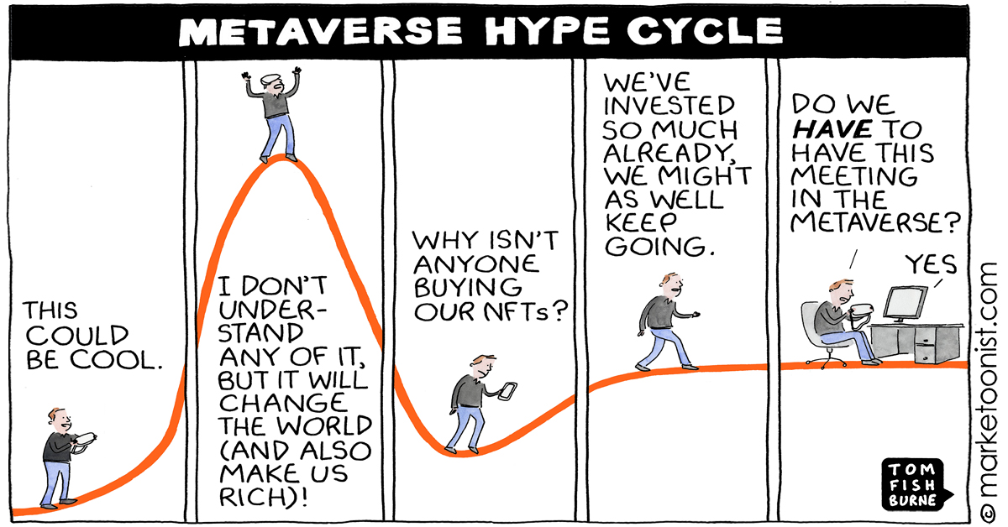
ISI
Reflexão:

Slide 4
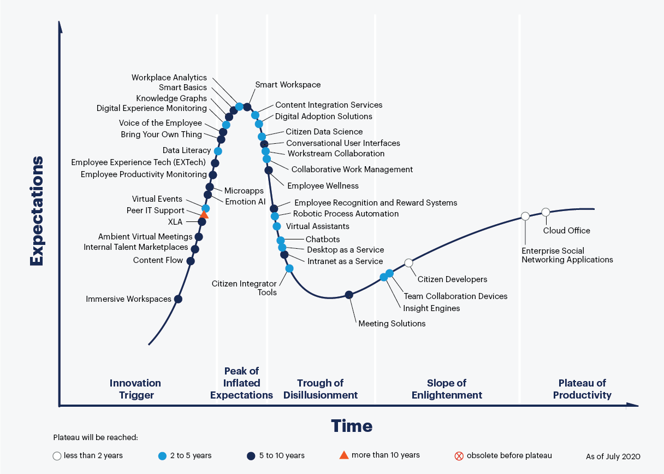
ISI
Reflexão:

Slide 5
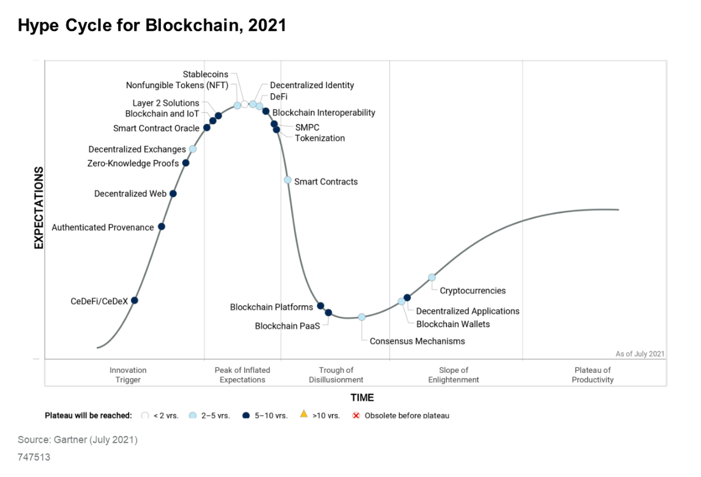
ISI
Reflexão:

Slide 6
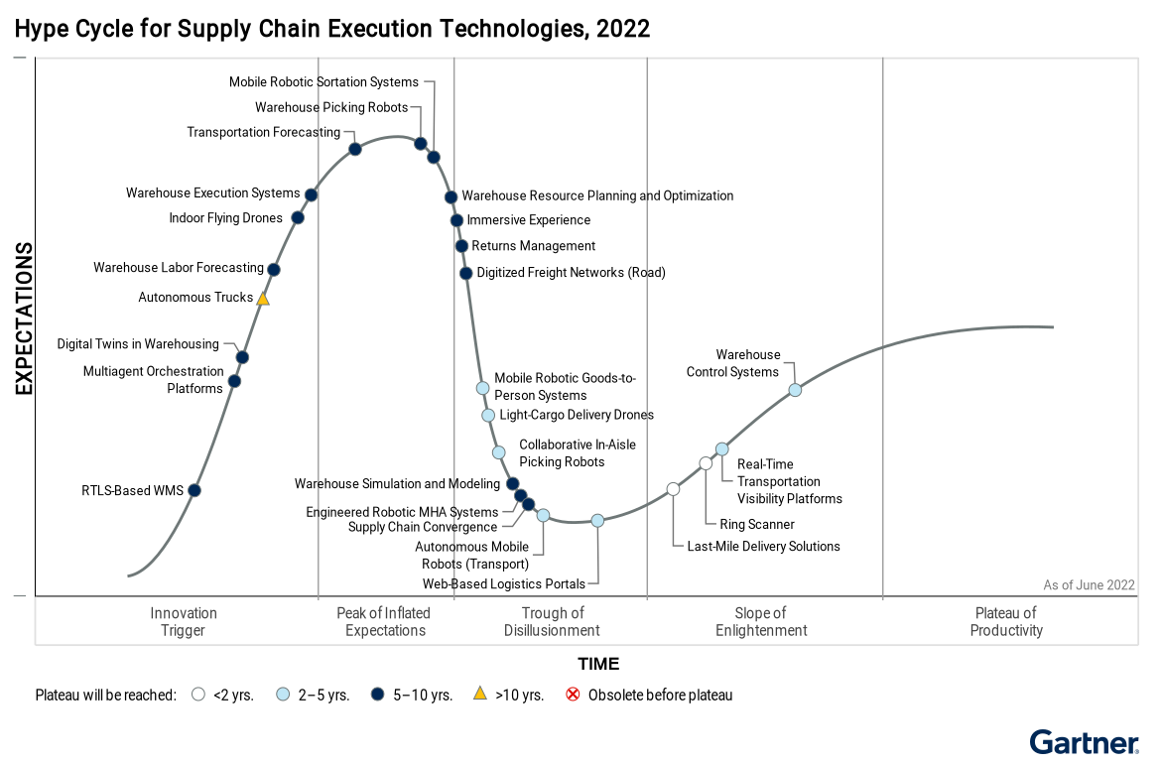
ISI
Reflexão:
See: Emerging Technology Roadmap for Large Enterprises
(https://emtemp.gcom.cloud/ngw/globalassets/en/publications/documents/le-emerging-tech-roadmap-2021-2023.pdf)

Slide 7
ISI
Reflexão:
Composite architectures | Composable Enterprises
  “…business expertise and technology expertise together to reengineer decision making…from the focus on stability to focus on agility and continuous change…”
Algorithmic trust | Authenticated provenance
  “…how do you know something is real and valid (Human, IA, Blockchain)…”
Beyond silicon | DNA computing and storage
  Digital (0|1) to DNA (adenine, thymine, guanine and cytosine, or “ATGC”)
“…From a resiliency and storage density perspective, nothing beats DNA. Properly stored, DNA can last for at least 500 years. And a gram of DNA can store over 200PB of data…”
Gartner 2020

Slide 8
ISI
Reflexão:
Formative AI | Generative AI | Generative Learning
  ”…it can improve or alter existing content and it can create new data elements or data itself…” – AI | Machine Learning
Digital me | Digital me: Bidirectional brain machine interface
  “…basically, reading the mental state of the individual, as well as potentially changing it…” ex: brain control exoskeleton
Industry 4.0 | Cyber Physical Systems
“…The pandemic rapidly elevated many digital workplace technologies from nice-to-have to must-have status…”
Gartner, 2020

Slide 9
ISI
Reflexão:
Decentralized identity
  ”…allows an entity (typically a human user) to control their own digital identity by leveraging distributed technologies…” – Blockchain, DLT
Metaverse
  “…collective virtual 3D shared space, created by the convergence of virtually enhanced physical and digital reality…”
Non-fungible token (NFT)
  “…unique programmable blockchain-based digital item that publicly proves ownership of digital assets…”
“…Immersive Experiences provide individuals with more control over their identities and data, and expand their range of experiences into virtual venues and ecosystems that can be integrated with digital currencies. These technologies also provide new ways to reach customers to strengthen or open up new revenue streams Gartner, 2022

Slide 10
ISI
Past….Present…Future
Este conjunto de slides pretende resumir a história do que mais relevante se passou nas Tecnologias de Integração….versão mais detalhada na sebenta da disciplina…
Cloud Computing
IoT
RESTful
Microservices
2015
2020

Slide 11
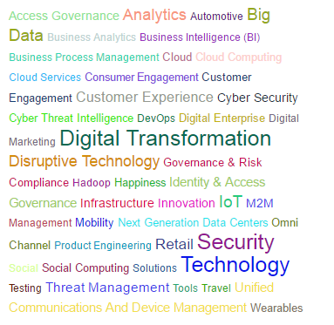
ISI
Past….Present…Future

Slide 12
ISI
Case Studies….
Empresa XPTO pretende inserir dados para facturar cliente Y…
Empresa XPTO pretende implementar Single-Sign-On (SSO) na sua empresa…
A Primavera SW pretende exportar dados SAF-T para serem validados pela ASAE…
Ministério da Justiça pretende interagir com o Ministério das Finanças…
Empresa XPTO pretende disponibilizar um conjunto de serviços a todas as suas filiais…
Etc.

Slide 13
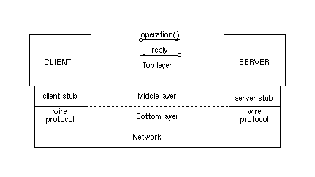
ISI
RPC

Slide 14
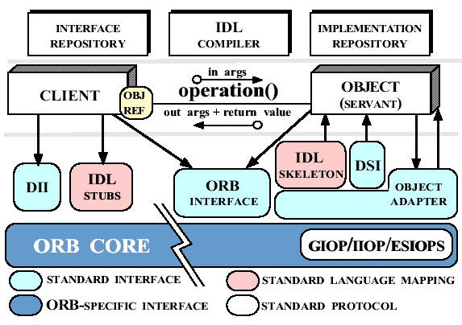
ISI
CORBA

Slide 15
ISI
XML WebServices
WSDL
Web service
consumer
Web service
developer
Http
Soap, XML, REST
Java, C, VB, Delphy, C#, Windows, Unix, Browser, Application
Java, C, VB, Delphy, C#, Windows, UNix

Slide 16
ISI
Until today….
Não partilha de recursos
Orientado ao Procedimento
Sockets – Comunicação inter-processos
Cliente Servidor – RPC – abstracção da localização
Isolated PC
Orientado a Objectos
CORBA, RMI, COM/DCOM
Sistemas Distribuídos
Network of PCs
PC “connected” via Web
Web Services – EAI/IAC/B2B/etc…
Web2.0, Web3.0
Microservices…

Slide 17
ISI
Overview
Desktop
Computer Networks
Companies Networks
Internet
Intranet
Cloud
IoT

Slide 18
ISI
Middleware
Middleware based on Messages – MOM
(message-oriented middleware)
Middleware based on Remote Procedures
Middleware based on Objects
...............
Database-Oriented Middleware
Transactional Middleware
Message Brokers
Web Services based Middleware

Slide 19
ISI
Middleware (patterns)
Models
  Logical - understanding how information "passes" from one entity to another
  Physical - understanding the technology and principles involved
Configurations
  Point-to-Point: RPC
  Many-to-Many: DCOM, Message Brokers
  Synchronous-Assynchronous
  With direct connection
  Without connection: queues; publish/subscribe; request/response; fire and forget

Slide 20
ISI
Middleware (solutions):
Remote Procedure Call (RPC)
Message-Oriented (MOM, JMS, MQSeries, MSMQ, etc.)
Object Oriented/Distribuído (CORBA, COM/DCOM, etc.)
Three-Tier Client-Server (J2EE, .NET, etc.)
TP Monitors (MTS); Application Servers (web); Message Brokers (webMethods)
Web Middleware

Slide 21
ISI
Integration: Patterns and Styles
EIP (Enterprise Integration Patterns), EAI, IAI
Depends of:
  People, Technology, Temporality, Functionalities, Data Format, etc..
Forms:
  Flat Files, Databases, Remote Processes, Messaging
Reflect on;
  Front-Ends, Data, Processes, Methods

Slide 22
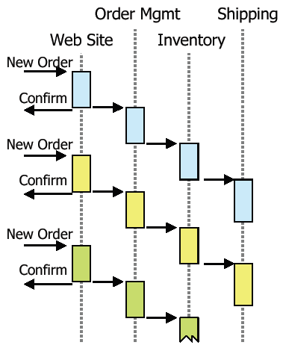
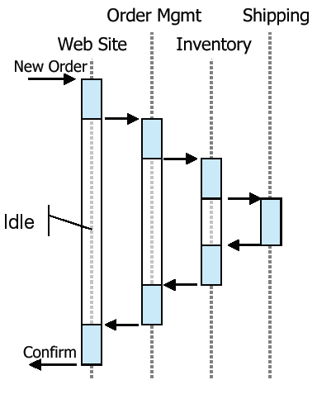
ISI
Asynchronous vs. Synchronous
Síncrono
Assíncrono

Slide 23
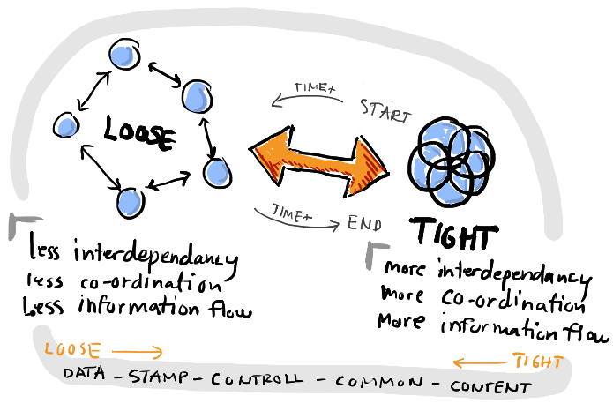
ISI
Tight coupling versus Loose coupling
https://infomgmt.wordpress.com/2010/02/18/a-visual-respresentation-of-coupling/

Slide 24
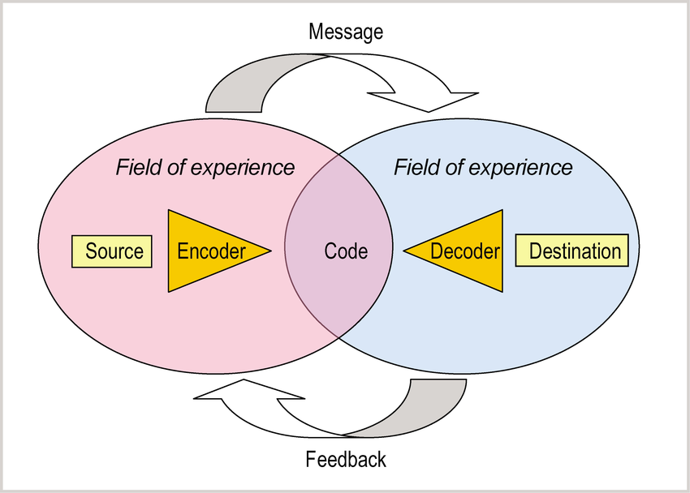
ISI
Transaction vs Interaction
https://www.researchgate.net/figure/232678987_fig3_Figure-2-Model-of-the-2-way-communication-process-based-on-Schramm-1961-Effective

Slide 25
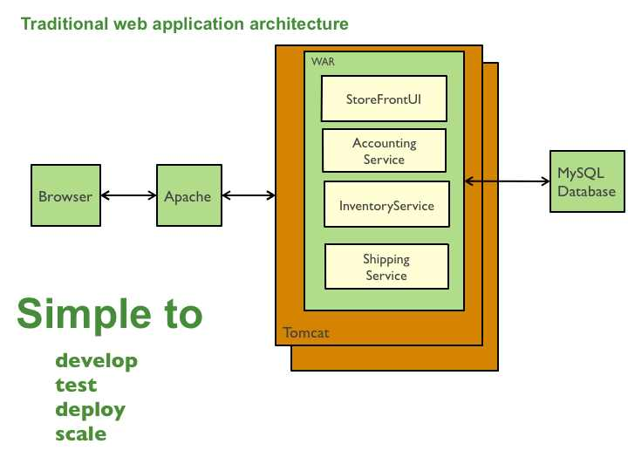
ISI
(traditional) Web Application Architecture
https://www.baeldung.com/tomcat-deploy-war
https://microservices.io/patterns/monolithic.html
WAR – Web ARchives

Slide 26
ISI
Cloud WebServices
WSDL
Web service
consumer
Web service
developer
Http
Soap, XML, REST
Threads
Asynchronous Controller
Parallel (broadcast – SignalR, WebRTC)
Real-Time
Data Streaming Analysis

Slide 27
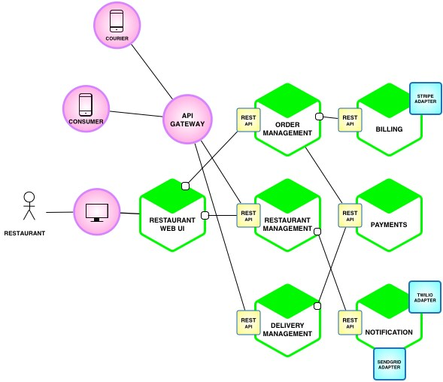
ISI
Microservices Architecture
https://microservices.io/patterns/microservices.html
https://freecontent.manning.com/the-purpose-of-microservice-architecture/

Slide 28
ISI
Case study: SuperApps
Composable Mobile Apps!
What architecture? Investigate!

Slide 29
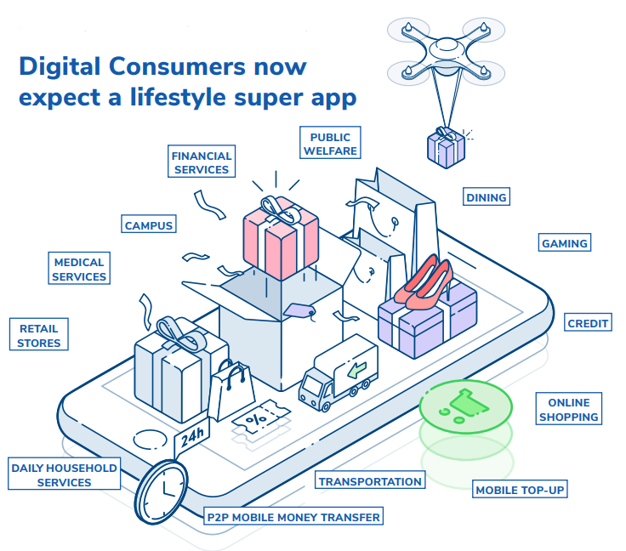
ISI
Case study: SuperApps
Composable Mobile Apps!
What architecture? Investigate!
https://blog.devgenius.io/a-brand-new-mobile-application-development-concept-super-app-financial-super-app-71f6fd8063e0

Slide 30
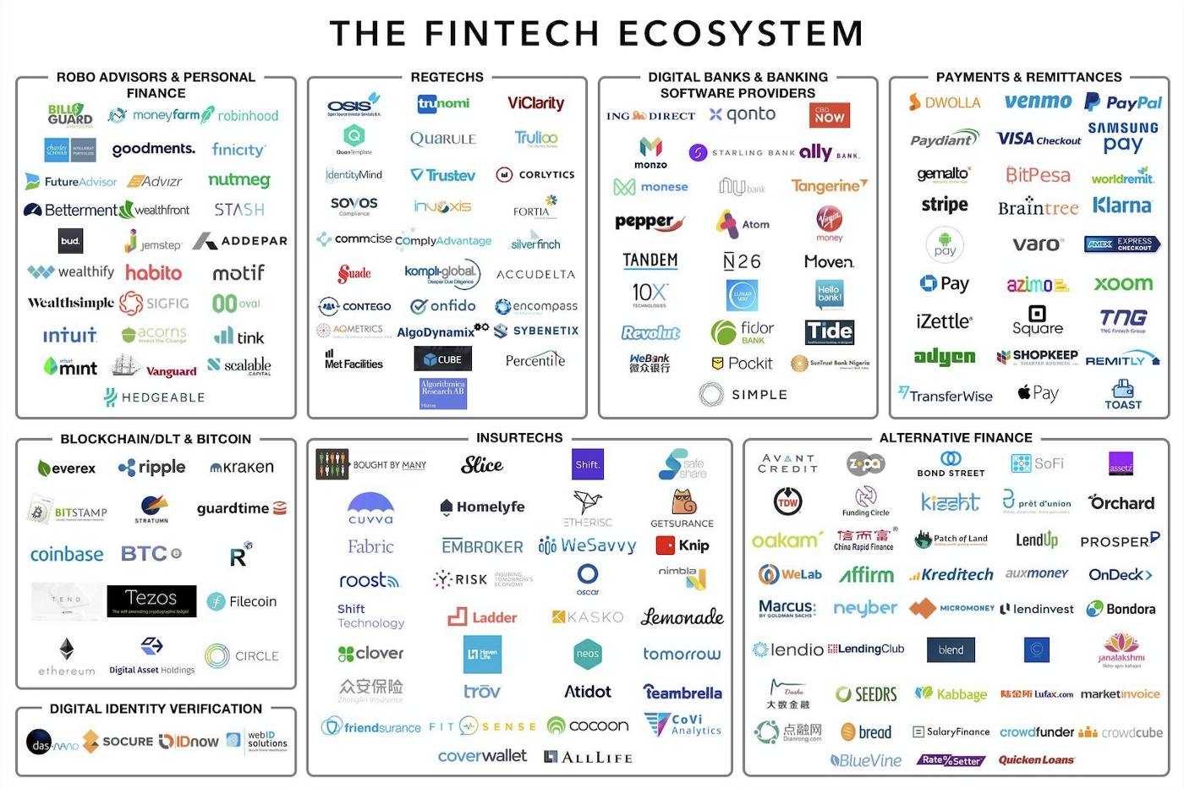
ISI
Case study: Financial Super App
What architecture? Investigate!
https://blog.devgenius.io/a-brand-new-mobile-application-development-concept-super-app-financial-super-app-71f6fd8063e0

Slide 31
ISI
Integrar …
Data
  XML, JSON, ETL
Front-End
  RIA Services, Rich Interfaces
Business Rules
  Web Services (REST, SOAP, WCF)
Semantics
  Ontologies, RDF

Slide 32
ISI
“Techologies” to explore:
XML/JSON
ETL: C#; Pentaho Kettle; SQLServer Integration Services (MSSIS) (optional)
  (optional) Javascript, Phyton, Perl
SOAP: (optional) PHP (>5.0);
Web Services:
  Web API | .NET Core (optional: PHP, JAVA)
  .NET Framework (>=3.0);
RESTful Services
  Cloud services: Windows Azure, gRPC, Insomnia, AppHarbor, others!
IoT:
  Node-RED

Slide 33
ISI
Commercial Platforms:
Microsoft Biztalk Server
IBM WebSphere
BEA WebLogic
Microsoft SQL Server Integration Services

Slide 34
ISI
References:
https://www.gartner.com/smarterwithgartner/5-emerging-technologies-explained-by-gartner-experts/
Xu, L. D. (2015). Enterprise Integration and Information Architecture - A Systems Perspective on Industrial Information Integration. CRS Press.

